Slide 1


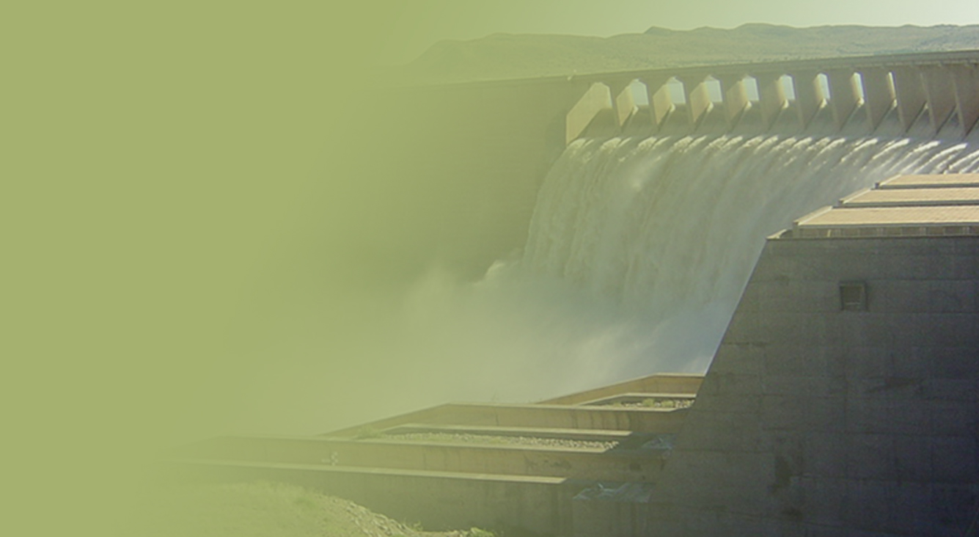
The Determination of Water Resources Classes and Resource Quality Objectives for the water resources in in the Breede-Gouritz WMA
Focus on Breede-Overberg area
Technical Task Group meeting 2: Presentation and workshopping of draft Resource Quality Objectives
Rivers:
Presented by: Karl Reinecke
12-16 March 2018
Graham & Rhona Beck Skills Centre, Robertson

Slide 2
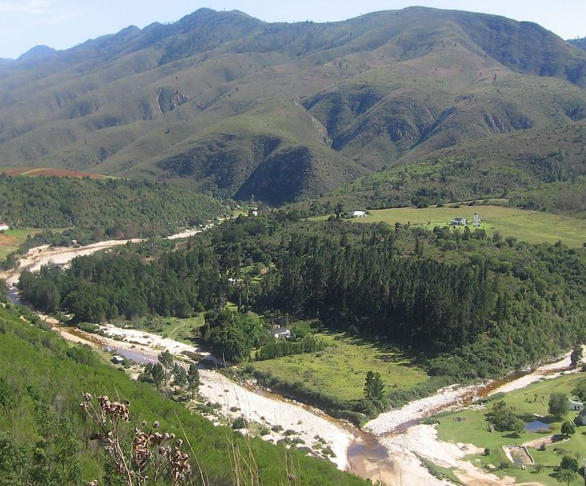

Overview of Study Progress

Slide 3
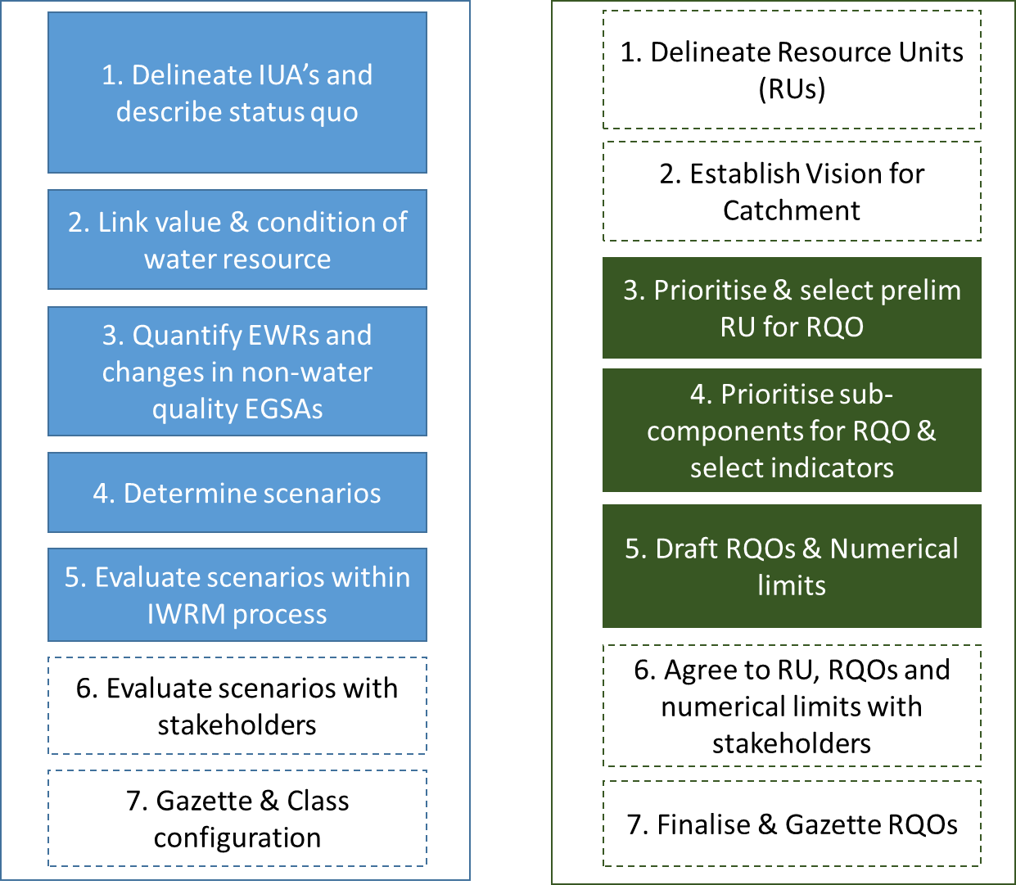

Classification and RQOs Steps
7-step process to determine WRCs
7-step process to determine RQOs
Aligned
Gazette WRC & RQO

Slide 4
Defined Integrated Units of Analysis (IUAs)
  Identified significant resources:
    Based on Physical, Biological & Socio-economic factors
  Each IUA represents a similar area requiring a Water Resources Class (WRC)
  Why do we need these?
    Broad-scale units to assess socio-economic implications of scenarios (possible future situations)
    Report on ecological conditions at a sub-catchment scale
    Set WR Classes for different parts of a catchment
  18 IUAs delineated - 10 in the Breede-Overberg & 8 in the Gouritz-Coastal areas

Slide 5
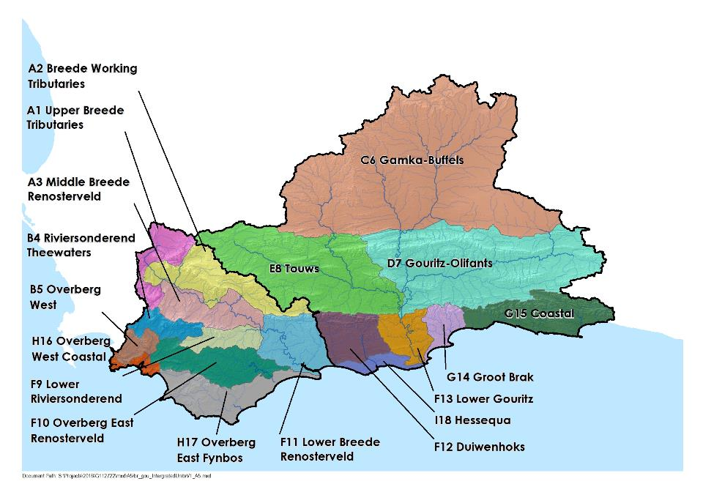
18 Integrated Units of Analysis

Slide 6
Defined Resource Units (RUs) and Nodes
Resource units (RUs) are grouped areas e.g. river basins, deemed similar in terms of various characteristics
Are used to transfer information between catchments
Groundwater
  Nodes are locations of interest (points) in a water resource (rivers, dams, wetlands, estuaries)
  Are sited using:
  Water infrastructure
  Aquatic ecosystem attributes
  Are used to allocate water for environment and development

Slide 7
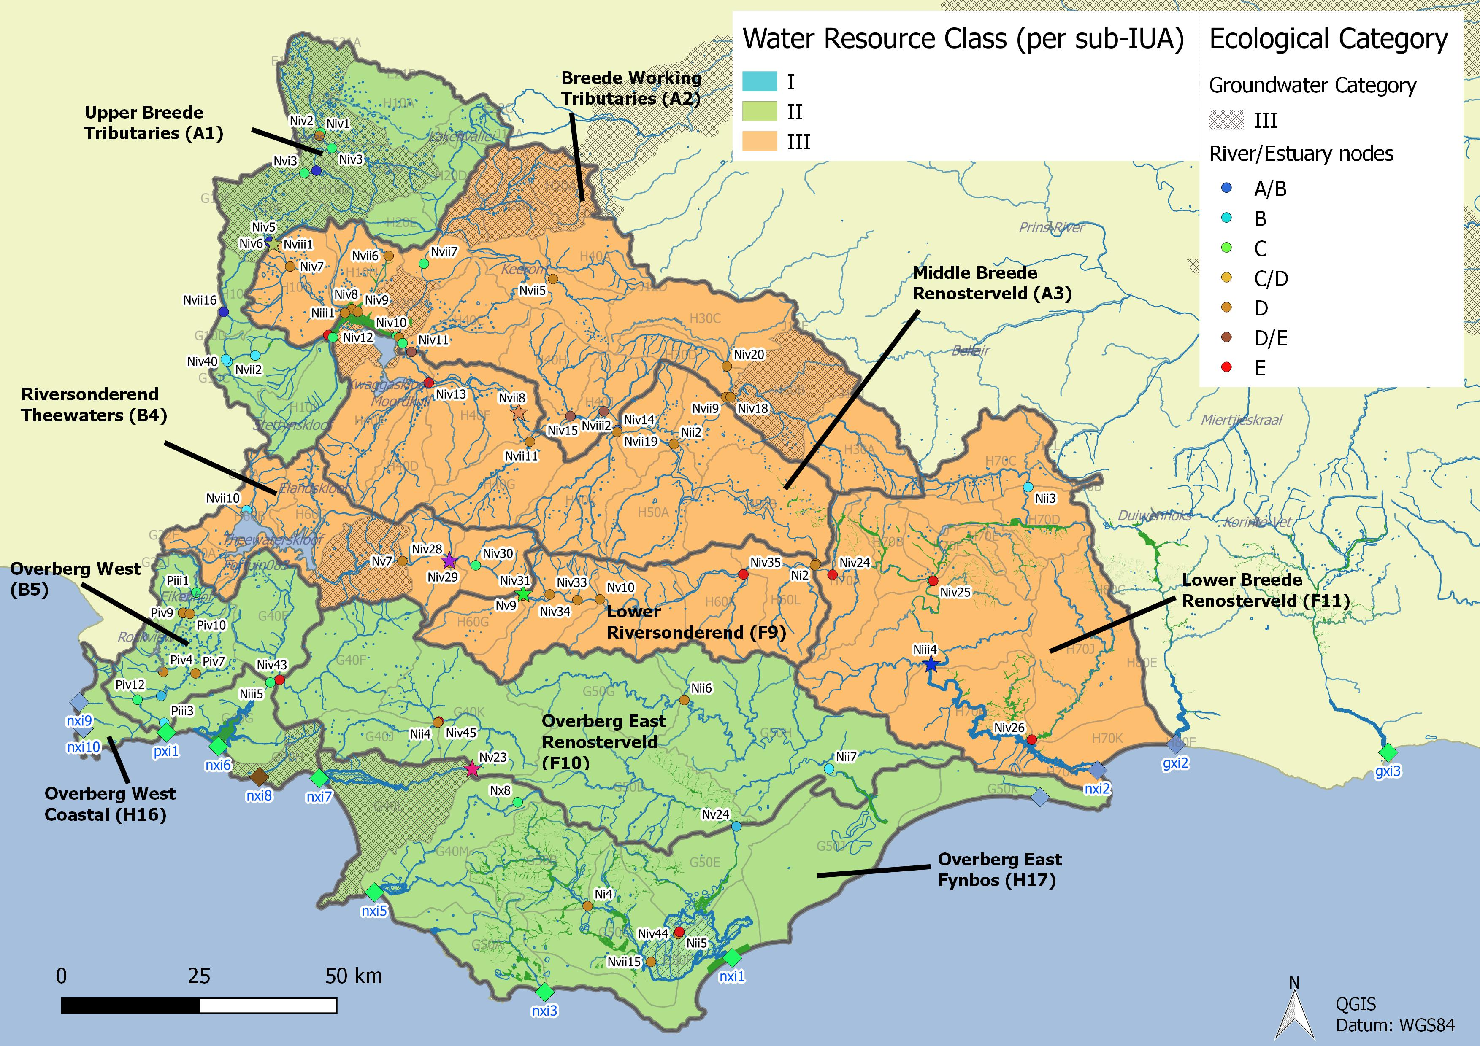
Integrated Units of Analysis and Nodes
Breede-Overberg Region

Slide 8
Breede-Overberg Region
 | Integrated Unit of Analysis (IUA) | Recommended Classes
 | A1 Upper Breede Tributaries | II
 | A2 Middle Breede Renosterveld | III
 | A3 Breede Working Tributaries | III
 | B4 Riversonderend Theewaters | III
 | F9 Lower Riversonderend | III
 | B5 Overberg West | II
 | H16 Overberg West Coastal | II
 | F10 Overberg East Renosterveld | II
 | H17 Overberg East Fynbos | III
 | F11 Lower Breede Renosterveld | II

Slide 9
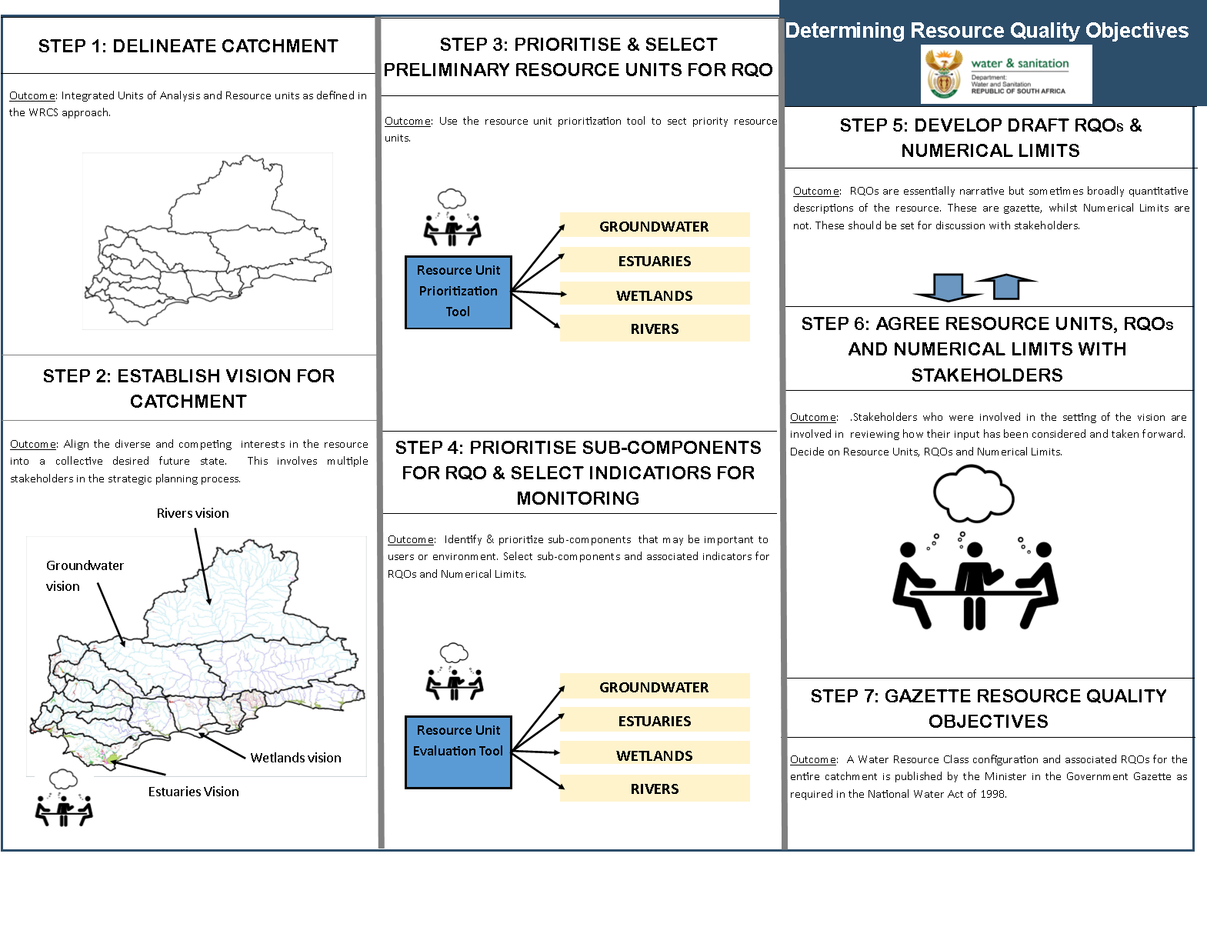
Study Status: RQOs
DAMS
Draft
Complete
Draft
Complete
DAMS
Draft
Notes:
Erik to present progress, Reminder of two stage process (Classification followed be RQOs – but gazetted together). Link to RQOs? Then zoom in on the classification process

Slide 10
Comments on draft RQO Reports
Three RQO Reports disseminated for comment:
  Resource Unit Prioritisation Report
  Evaluation of Resource Units Report
  Outline of RQOs Report
Please provide comment by 22 March to:
  Esther Lekalake (LekalakeE@dws.gov.za), or
  Louise Lodenkemper (Louise.Lodenkemper@aurecongroup.com)

Slide 11
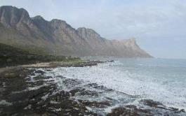
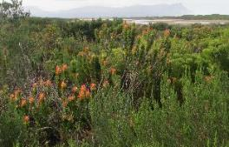
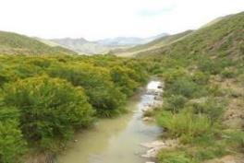
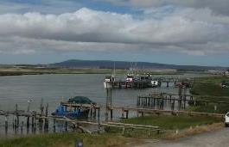
Thank you, Any discussion?

Slide 12
Determination of RQOs

Slide 13
Terminology
Ecological Reserve studies – set flow quality and quantity for water resource condition and basic human needs
  Ecological Water Requirement (EWR) sites
Classification – determines condition classes I – III
  Integrated Units of Analysis (IUA)
Resource Quality Objectives – descriptive (words) and numerical (number) statements to measure resource quality
Resource Units – rivers, lakes, wetlands, groundwater

Slide 14
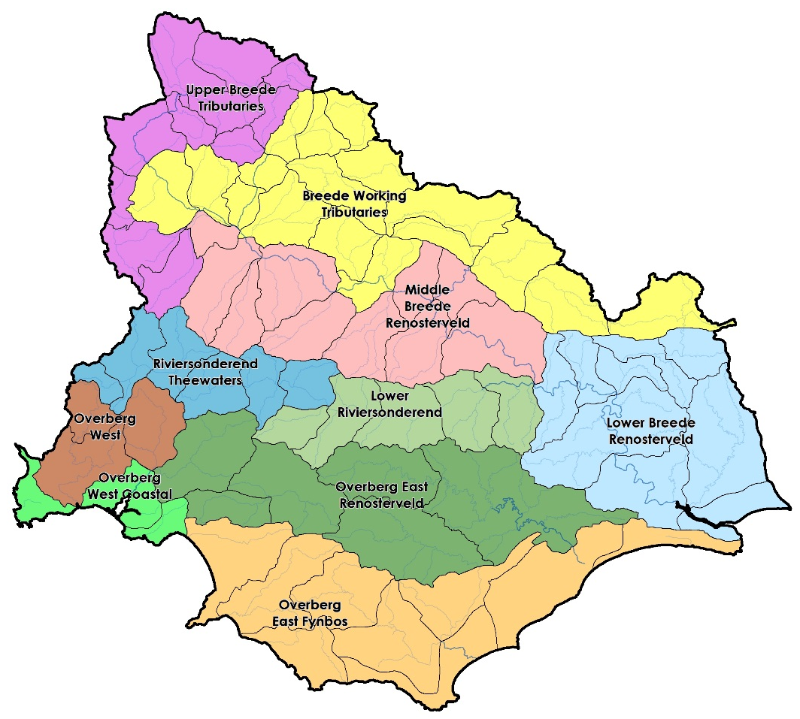
Steps to RQOs
IUAs - a combination of socio-economic and biotic boundaries
RUs for rivers were quaternary catchments
  RUs were prioritised
  RUs were evaluated
  RQOs were written
Notes:
Part of the purpose is to try focus attention at all the areas of the basin that differ from one another…to be representative as a whole across the basin

Slide 15
Resource Unit priorities - method
2 levels of ranking RUs at a quaternary level
  Quats with nodes were selected first as these were chosen for a range of biophysical, water resource and socio-economic reasons
  The ‘DWS RU prioritisation tool’ was used to rank RUs against one another based on:
    position, socio-economic and international importance
    roles in regulating services and ecological importance
    management actions needed or taking place
Notes:
Management only looks at nodes in poor condition and then EWR sites

Slide 16
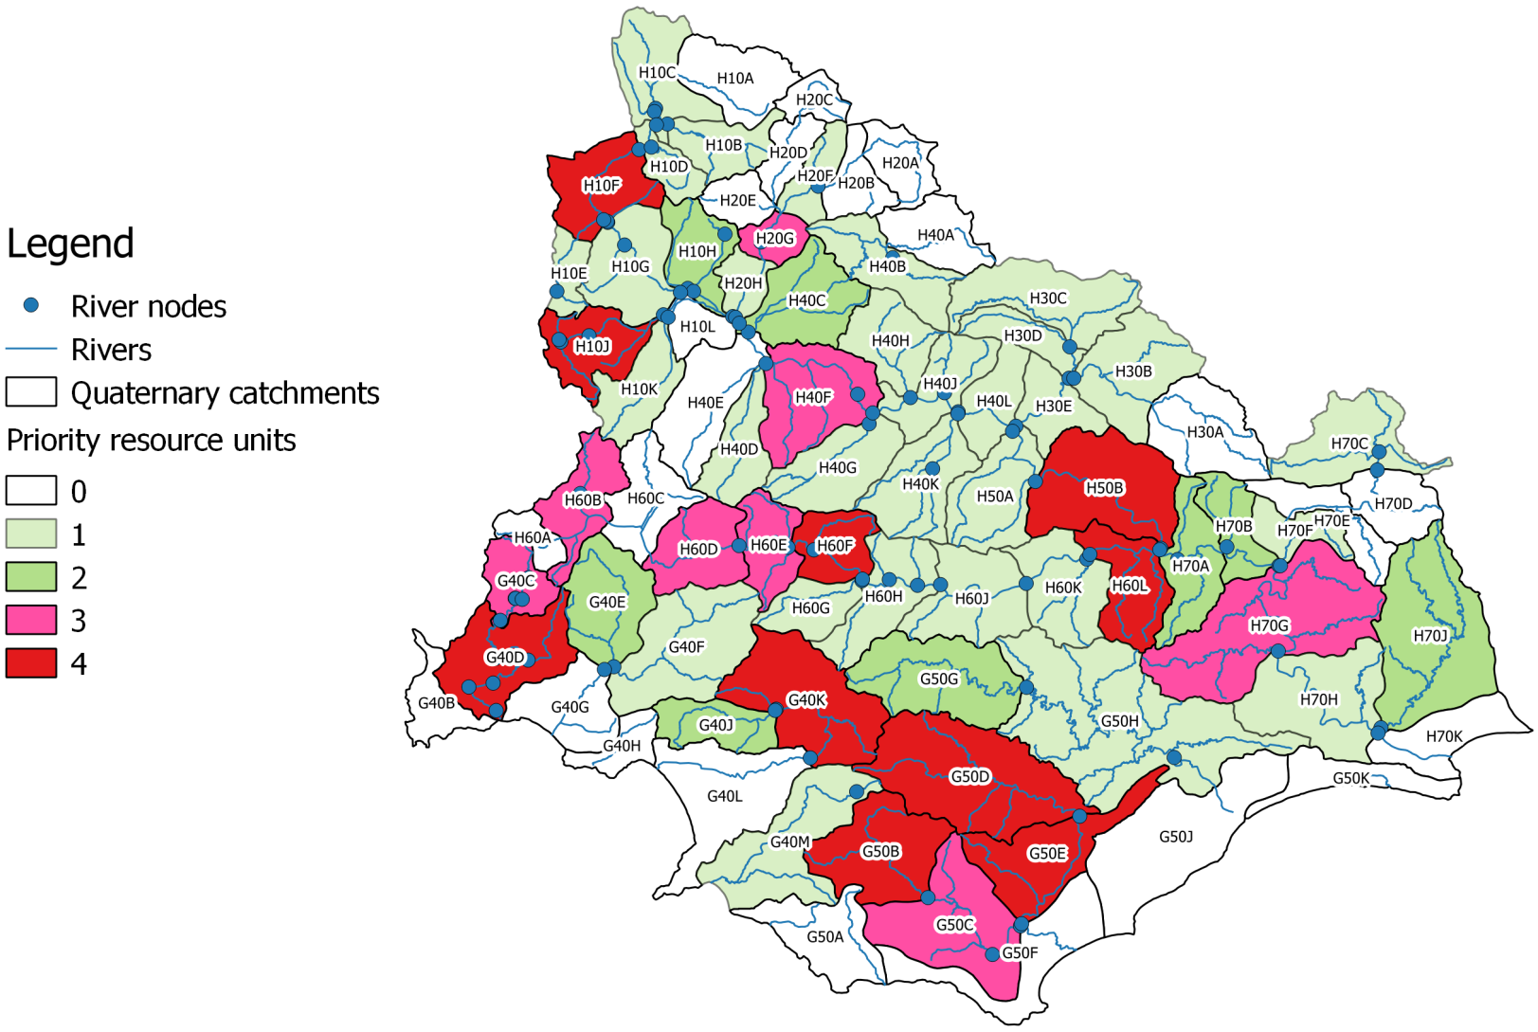
High and low priority RUs

Slide 17
High priority RUs

Slide 18
Evaluation of RUs - method
The ‘DWS RU evaluation tool’ was used to select indicators for which RQOs (descriptive and numerical) were written based on:
  Activities that impact on the water resource
    Dams, IBTs, afforestation, agriculture and so on
  User requirements
    Conservation and ecosystem characteristics (including PES, trajectory of change)
    Industry, agriculture, ecotourism, real estate (including fitness for use and trajectory of change)
Notes:
Evaluation of Rus method statement

Slide 19
Examples of indicators
Hydrology - low flows and high flows, monthly average volume (MCM)
Ecological condition – IHI, PAI, GAI, VEGRAI, MIRAI, FRAI
Water quality – nutrients, salinity, system variables, toxins and pathogens
Geomorphology – sediment particle size (e.g. D₅₀)
Aquatic and riparian vegetation - % cover of indigenous and alien plants species in 3 zones
Macroinvertebrates – SASS and ASPT scores, # of families present, key indicator families
Fish – CPUE of fish species present, FROC
Notes:
RQOs method statement

Slide 20
RQOs - method
TEC was the REC classification scenario
17 high priority RUs in the Breede and Overberg; 3 other rivers were estuarine in character
  Descriptive RQOs, numerical limits and TPCs
66 Breede River nodes and 23 Overberg nodes
  Hydrological and ecological condition RQOs
Notes:
RQOs method statement

Slide 21
Breede and Overberg RQOs – low priority
Target Ecological Condition from the REC scenario
Monthly average volume (MCM) that includes inter-annual floods (return period > 2 years)
Annual volume (MCM) – sum of months
%nMAR – annual flow as a % of natural

Slide 22
Breede River basin RQOs – high priority
3 different sets
BRBS 2002
  E.g. BREE_BREE_H10F
Hex River 2002
  E.g. BREE_HEX_H20G
Other
  E.g. BREE_DUTO_H60B
Notes:
DRAFT RQOs

Slide 23
Overberg high priority RUs
2 different sets
Palmiet River Reserve study 2002
  E.g. OVER_PALM_G40C
Rapid IIIs (this study)
  E.g. OVER_NUWE_G50B

Slide 24
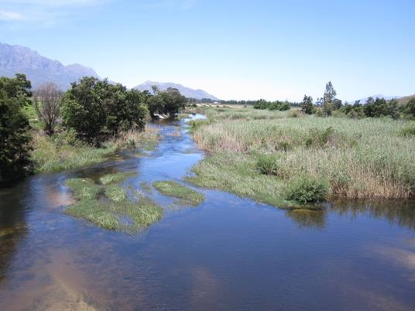
Breede River @ BREE_BREE_H10F

Slide 25
Breede River @ BREE_BREE_H10F
Flow
Data exclude inter-annual floods

Slide 26
Breede River @ BREE_BREE_H10F
Sub-component | TEC | RWQO | Indicator | Numerical Limits | Present state (50/95%tile) H1H006Q01
Nutrients | B | Maintain river in a mesotrophic or better condition. | Phosphate (PO₄-P) Total inorganic nitrogen (TIN) | Median ≤ 0.075 mg/l PO₄-P Median ≤ 1.75 mg/l TIN | PO4 0.006 / 0.034 TIN 0.78 / 01.961
Salts |  | Maintained at levels that do not adversely affect aquatic ecosystems | Electrical conductivity (EC) | Median ≤ 55 mS/m EC | EC 15 / 38.9
System variables |  | pH, temperature, and dissolved oxygen are important for ecosystem health. | pH Water temperature Dissolved oxygen | 6.5 ≥ pH ≤ 8.5 2°C difference from ambient Median DO ≥ 6 mg/l | pH 7.2 / 7.6 No temp data No DO data
Toxins |  | Acceptable category | Substances WQ Reserve methods | Limits specified in WQ reserve methods | No data
Pathogens |  | Maintain in Acceptable cat (contact recreation) | E coli / Faecal coliforms | Median ≤ 130 cfu/100ml | E coli 20/461 F coli 37/957

Slide 27
Breede River @ BREE_BREE_H10F

Slide 28
Breede River @ BREE_BREE_H10F
Dallas (2007)

Slide 29
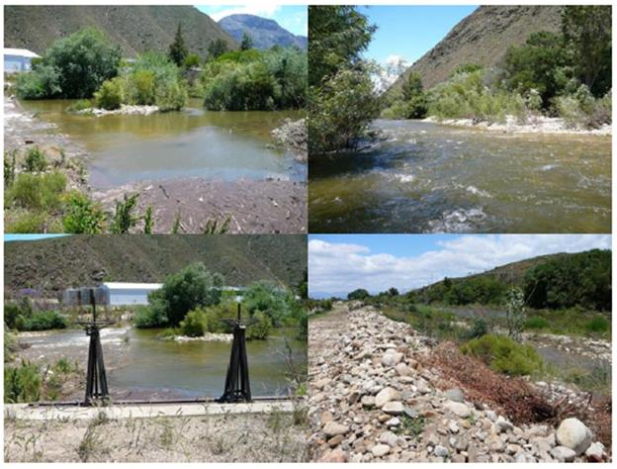
Hex River @ BREE_HEX_H20G

Slide 30
Hex River @ BREE_HEX_H20G
Flow
Data exclude inter-annual floods

Slide 31
Hex River @ BREE_HEX_H20G
Sub-component | TEC | RWQO | Indicator | Numerical Limits | Present state (50/95%tile) H2H006Q01
Nutrients | B | Maintain river in a mesotrophic state | Phosphate (PO₄-P) Total inorganic nitrogen (TIN) | Median ≤ 0.075 mg/l PO₄-P Median ≤ 1.75 mg/l TIN | PO4 0.035 / 0.159 TIN 0.261 / 0.895
Salts |  | Maintained at acceptable levels for aquatic ecosystems | Electrical conductivity (EC) | Median ≤ 55 mS/m EC | EC 15 / 23.4
 |  | pH, temperature, and dissolved oxygen for the maintenance of ecosystem health. | pH Water temperture Dissolved oxygen | 6.5 ≥ pH ≤ 8.5 2°C difference from ambient Median DO ≥ 6 mg/l | pH 7.5 / 7.9 No temp data No DO data
System variables |  | pH, temperature, and dissolved oxygen are important for the maintenance of ecosystem health. | pH Water temperture Dissolved oxygen | 6.5 ≥ pH ≤ 8.5 2°C difference from ambient Median DO ≥ 6 mg/l | pH 7.5 / 7.9 No temp data No DO data
Toxins |  | Acceptable category | Substances WQ Reserve methods | Limits specified in WQ reserve methods | No data
Pathogens |  | Maintain in Acceptable cat (contact recreation) | E coli / Faecal coliforms | Median ≤ 130 cfu/100ml | No data

Slide 32
Hex River @ BREE_HEX_H20G

Slide 33
Hex River @ BREE_HEX_H20G
Dallas (2007)

Slide 34
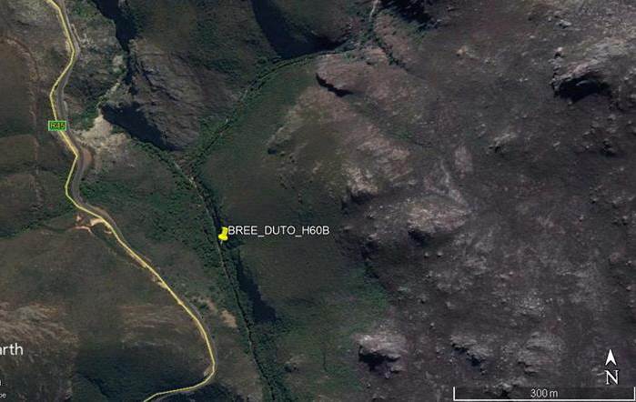
BREE_DUTO_H60B

Slide 35
Du Toits River @ BREE_DUTO_H60B
Flow
Data exclude inter-annual floods

Slide 36
Du Toits River @ BREE_DUTO_H60B
Sub-component | TEC | RWQO | Indicator | Numerical Limits | Present state (50/95%tile) H6H015Q01
Nutrients | A | Maintain river in an oligotrophic condition. | Phosphate (PO₄-P) Total inorganic nitrogen (TIN) | Median ≤ 0.025 mg/l PO₄-P Median ≤ 0.70 mg/l TIN | PO4 0.005 / 0.015 TIN 0.34 / 0.71
Salts |  | Maintained at near natural levels | Electrical conductivity (EC) | 95%tile ≤ 30 mS/m EC | EC 7.4 / 10.5
System variables |  | pH, temperature, and dissolved oxygen are important for the maintenance of ecosystem health. | pH Water temperature Dissolved oxygen | 6.5 ≥ pH ≤ 8.5 2°C difference from ambient Median DO ≥ 8 mg/l | pH 7.1 / 7.6 No temp data No DO data
Toxins |  | Acceptable category | Substances listed in WQ Reserve methods | Limits specified in WQ reserve methods | No data
Pathogens |  | Maintain in Ideal category for contact recreation | E coli / Faecal coliforms | Median ≤ 130 cfu/100ml | No data

Slide 37
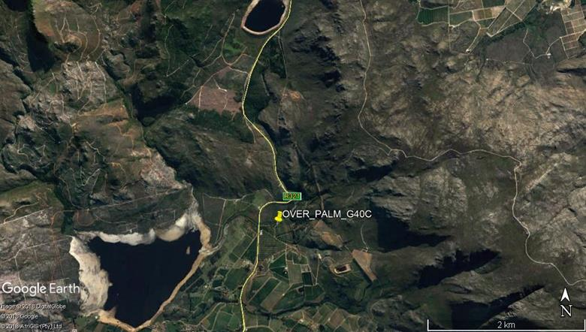
Palmiet River @ OVER_PALM_G40C

Slide 38
Palmiet River @ OVER_PALM_G40C
Flow
Data exclude inter-annual floods

Slide 39
Palmiet River @ OVER_PALM_G40C
Sub-component | TEC | RWQO | Indicator | Numerical Limits | Present state (50/95%tile) G4R002Q01
Nutrients | B | Maintain river in an mesotrophic state | Phosphate (PO₄-P) Total inorganic nitrogen (TIN) | Median ≤ 0.015 mg/l PO₄-P Median ≤ 0.70 mg/l TIN | PO4 0.010 / 0.030 TIN 0.05 / 0.153
Salts |  | Maintained at near natural levels | Electrical conductivity (EC) | 95%tile ≤ 30 mS/m EC | EC 7 / 8
System variables |  | pH, temperature, and dissolved oxygen to maintain ecosystem health. | pH Water temperature Dissolved oxygen | 6.5 ≥ pH ≤ 8.5 2°C difference from ambient Median DO ≥ 8 mg/l | pH 5.1 / 7.1 No temp data No DO data
 |  | Ideal category | Substances listed in WQ Reserve methods | Limits specified in WQ reserve methods | No data
Toxins |  | Ideal category | Substances listed in WQ Reserve methods | Limits specified in WQ reserve methods | No data
Pathogens |  | Maintain in Acceptable cat (contact recreation) | E coli / Faecal coliforms | Median ≤ 130 cfu/100ml | No data

Slide 40
Palmiet River @ OVER_PALM_G40C

Slide 41
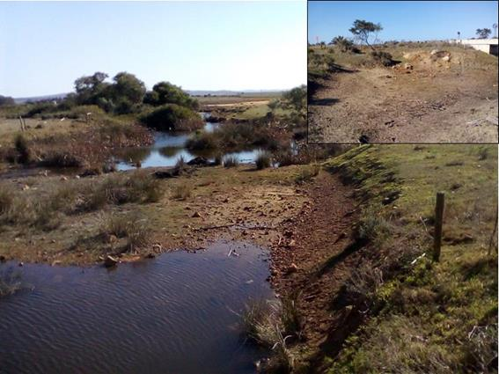
Nuwejaars River @ OVER_NUWE_G50B

Slide 42
Nuwejaars River @ OVER_NUWE_G50B
Flow
Data exclude inter-annual floods

Slide 43
Nuwejaars River @ OVER_NUWE_G50B
Sub-component | TEC | RWQO | Indicator | Numerical Limits | Present state (50/95%tile) No mon pnt
Nutrients | D | Maintain river in an mesotrophic condition. | Phosphate (PO₄-P) Total inorganic nitrogen (TIN) | Median ≤ 0.075 mg/l PO₄-P Median ≤ 1.75 mg/l TIN | No data
Salts |  | Maintained at near natural levels | Electrical conductivity (EC) | Median ≤ 170 mS/m EC | No data
System variables |  | pH, temperature, and dissolved oxygen are important for the maintenance of ecosystem health. | pH Water temperature Dissolved oxygen | 6.5 ≥ pH ≤ 8.5 2°C difference from ambient Median DO ≥ 8 mg/l | No data No temp data No DO data
 |  | Acceptable category | Substances listed in WQ Reserve methods | Limits specified in WQ reserve methods | No data
Toxins |  | Acceptable category | Substances listed in WQ Reserve methods | Limits specified in WQ reserve methods | No data
Pathogens |  | Maintain in Acceptable cat (contact recreation) | E coli / Faecal coliforms | Median ≤ 165 cfu/100ml | No data

Slide 44
SWA, FEPAs and protected areas
FEPAs, CBAs, ESAs
SWA, where current day > 70% of natural
Rivers important for fish conservation
Table of quaternary and/or coordinate taking note of these areas but not writing RQOs specifically – double edged sword?
Will not be gazetted but part of the RQO document

